Slide 1
Just Another Movie:
Update 1
Kaitlyn Hardin, Robert Jones, Hayden Richard, Emmett Storey

Slide 2
Outline
Frontend
Backend
AI
Database
System Design
Conclusion

Slide 3
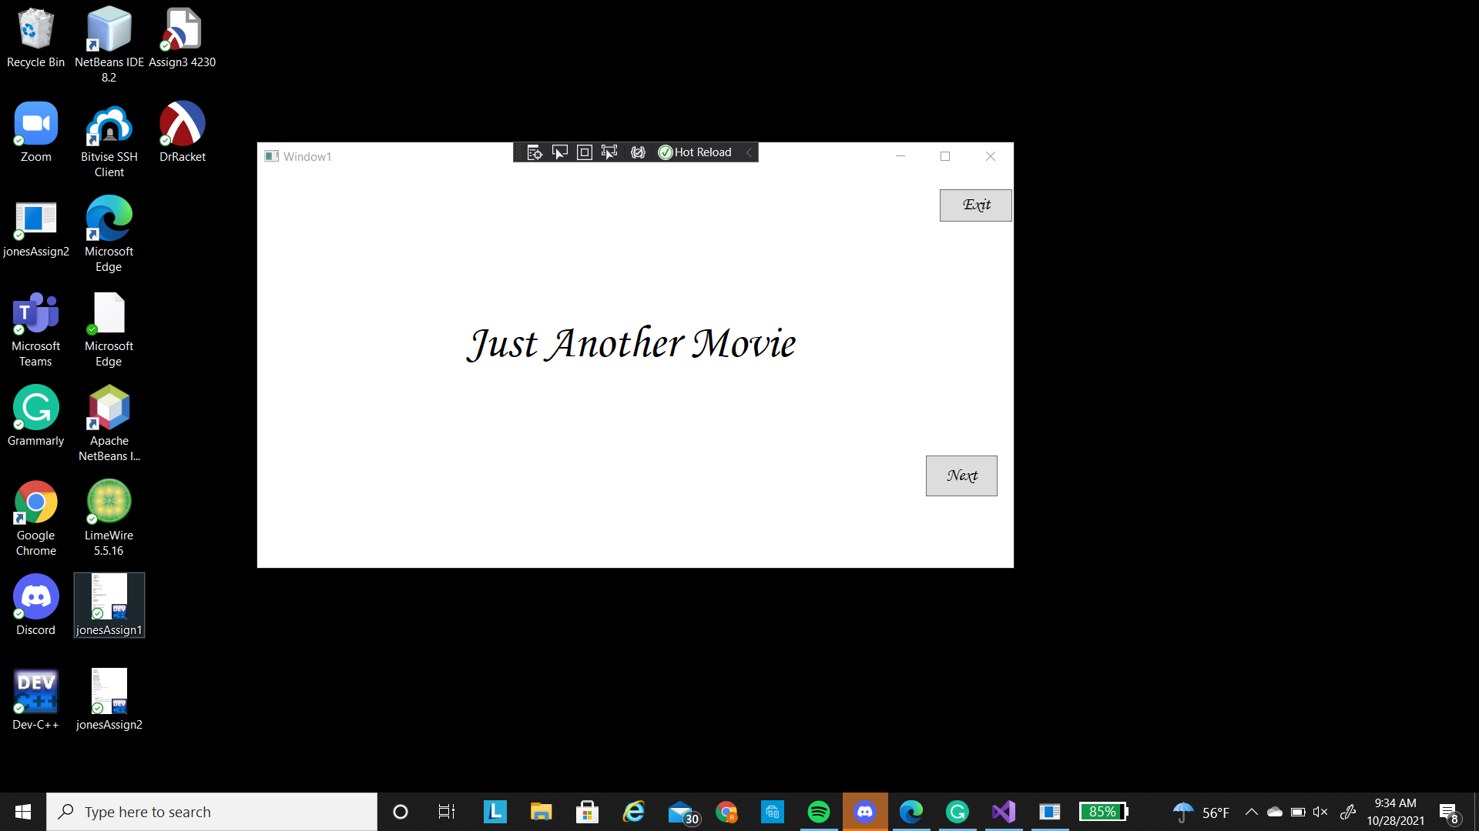
Frontend Development

Slide 4
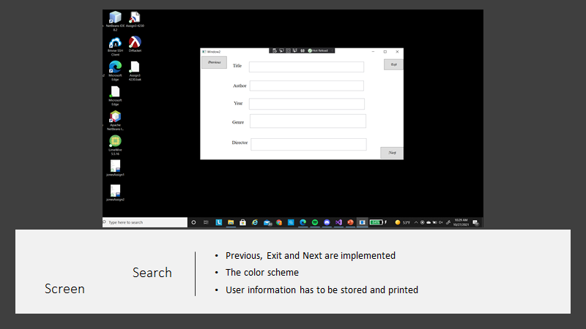
Search Screen

Slide 5
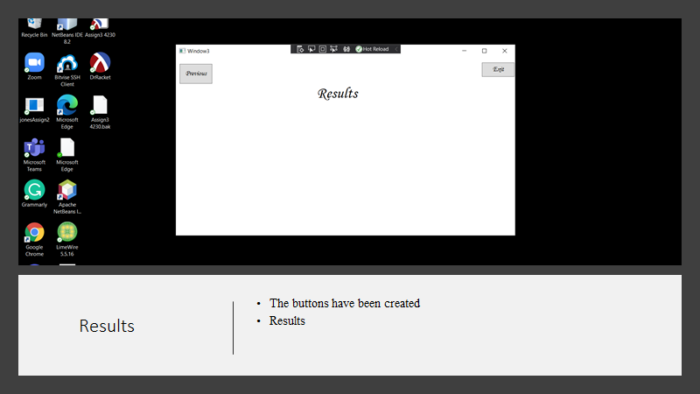
Results Page

Slide 6
Backend Development
The Movie, UserInput, and MovieList classes have been implemented.
Error handling class still needs one function to be implemented.
The Query class still needs the connection string to access the database.
Tests still need to be made.

Slide 7

Backend Development Changes
Query class has been created to handle query search and mostly replaces the AI class.
allInputEmpty() has been removed from the ErrorHandling class.
An addMovie() method has been added to the MovieList class.

Slide 8
Backend Development
Problem:
One of the problems the main problems is my lack of experience in interacting from databases and SQL.

Slide 9
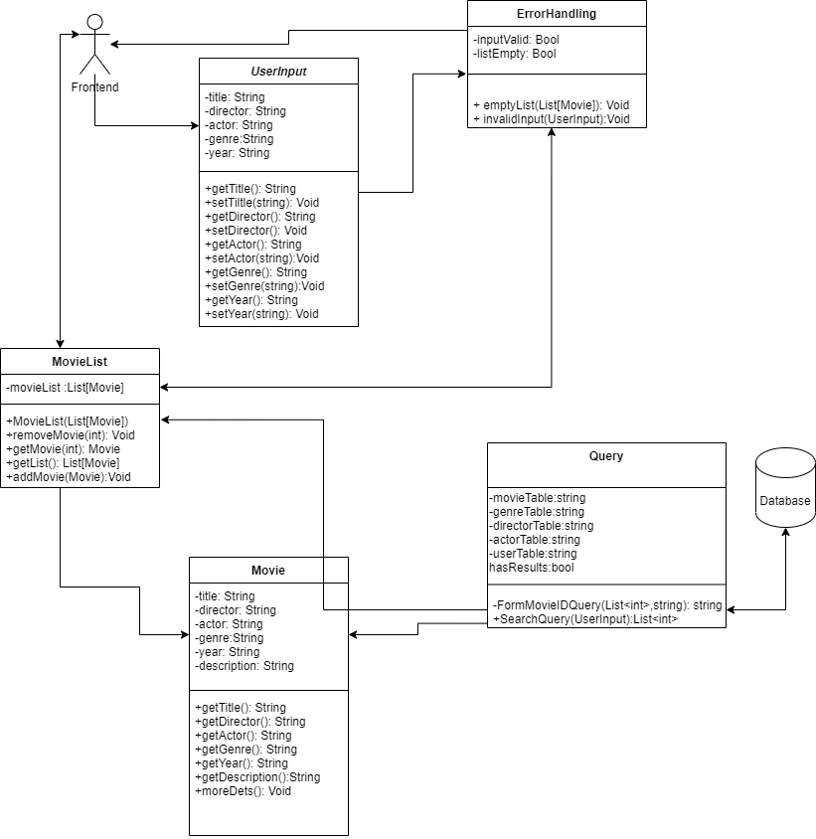
New backend Diagram

Slide 10
AI Development
What has been completed?
Have successfully built the AI and generated recommendations but with lower results than we want.
What still needs to be implemented?
Save the trained model to a .zip file.
Get the data split into test and training data.
Find the right size of test to train data size for the best results.
Optimize the matrix factorization algorithm for better results.

Slide 11
Problems Encountered with the AI
The data we are using, the people that made it randomized the user id’s and movie id’s.
The Microsoft library we are using for the AI wants all the data in a IDataView interface, I am getting a error saying it’s not in the proper interface.

Slide 12
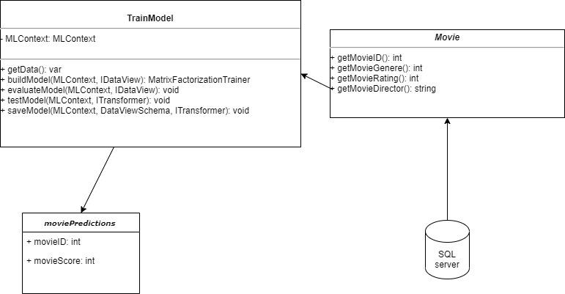
Old AI Design

Slide 13
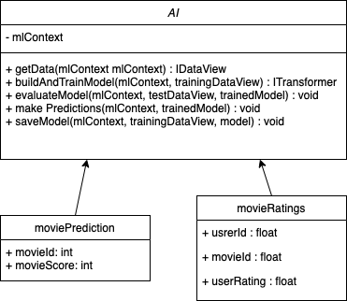
New AI Design

Slide 14
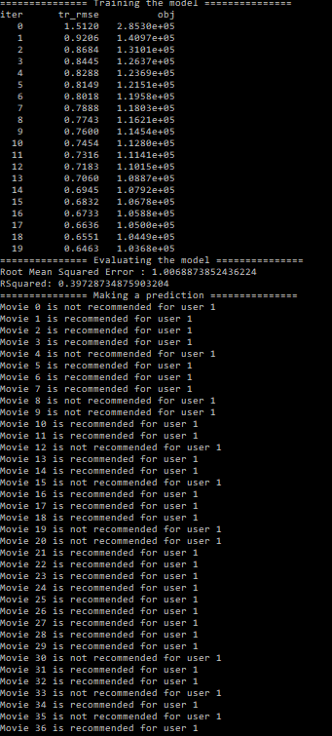
Example Output

Slide 15
Database Development
What’s fully implemented?
Database hosted
1
What’s started but not completed?
Database tables
2
What needs to be implemented?
Database connection
3

Slide 16
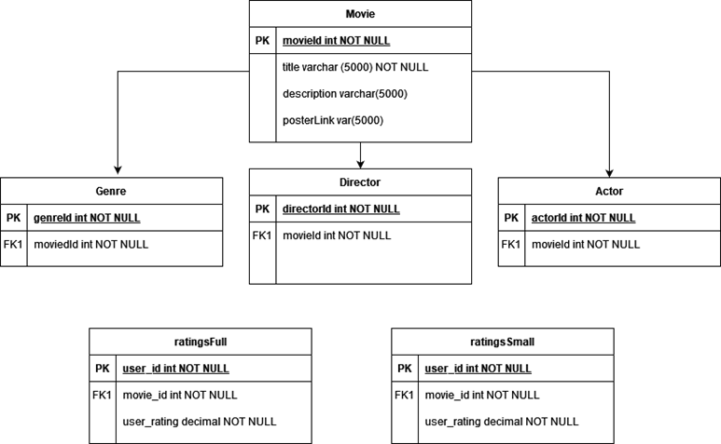

Slide 17
Database Development
Problems:
Hosting web server
Extracting data
Database connection

Slide 18
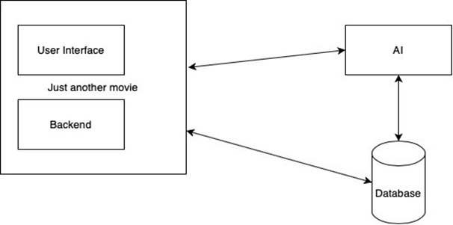
New System Design

Slide 19

Thank You For Listening!

